Slide 1





Q&A
2025

Slide 2
Small Grants Scheme
An incredible opportunity for communities to apply for a grant between £500 to £3000 to improve their environment and promote a cleaner, green and safer place to live.
Aimed at promoting civic pride and improving the environmental quality of shared community spaces.
Empowers volunteers to transform shared greenspaces for the benefit of the community and the environment.
Funded by 10 Local Councils, NIHE, Belfast Harbour, and supported by Keep Northern Ireland Beautiful.

Slide 3
Aims & Objectives
Projects must meet one or more of the following objectives:
Contribute to the development of civic pride within a community
Enhance the environmental management of a local area
Improve the health and wellbeing of communities whilst helping to improve and/or maintain public spaces
Improve the quality of the local environment by reducing littering and dog fouling through community action
Support environmentally focused actions that help support people impacted through reduced contact with society
Relate to environmental improvement in coastal areas or inland waterways

Slide 4
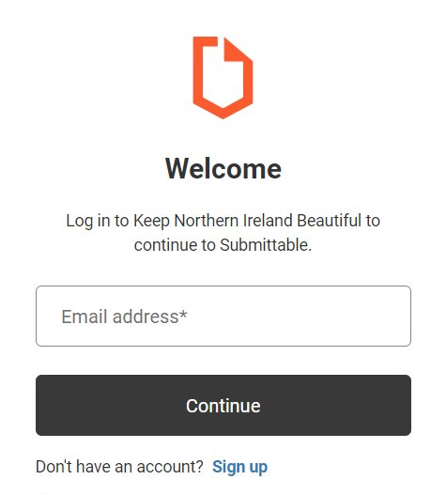
Apply via Submittable
Create a login using your email address and a password.
This must be the person who is responsible for the project and the grant award.
Complete the Eligibility form and submit. If this states you are ineligible, your answer to these questions have prompted this. If you believe you are eligible, try the checker again. We are unable to advise on specific responses to this form.
Eligible – you can move on to complete your application.
Read the Guidance Notes carefully and ensure you are answering the questions correctly.
Once your application is submitted it cannot be changed and will be assessed based on the information provided.

Slide 5
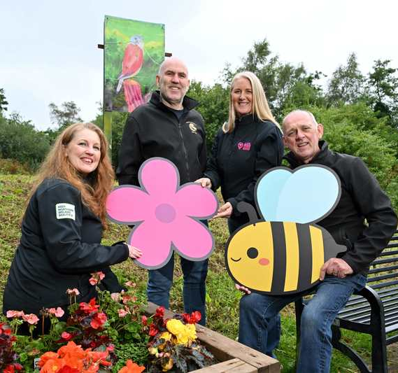
Who's it for?
Your group must either manage and/or own a publicly accessible space, or, if not, have a clearly defined role in its management, formally agreed upon with the landowner. For the purposes of this Scheme, school, church and sports grounds are considered public open spaces.
Applications are welcome from:
Volunteer and community groups (including non-constituted)
Youth groups, sports clubs, churches
All schools and third-level education organisations
Not-for-Profit Organisations
Previous LHLH grant recipients may apply

Slide 6
Key information:
Grants available between £500 - £3,000
Non-constituted groups: £1,000
Match funding is not required
The lead volunteer should make the application
A second contact required
Research your costs and provide quotes to benefit your application
70% upfront can be requested if successful
Register and apply through Submittable
Feedback on unsuccessful applications are not available

Slide 7
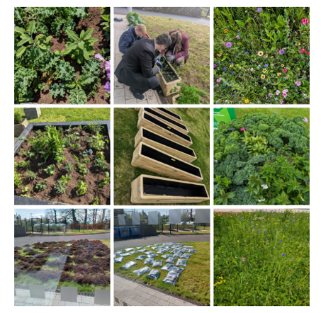
Types of projects we fund:
Greening up projects
Clean-up projects or litter picks
Community gardens
Food growing initiatives
Supporting biodiversity and wildlife
Planting for pollinators
Tools and equipment for community projects
For the full list of projects funded in your area in 2024/25 check our website here.

Slide 8
We do not fund:
Project running costs (salaries, insurance, mileage etc)
Large machinery or electronic equipment
Projects by individuals/sole applicants
Note: This list is not exhaustive
Items for individual/personal use
Costs for events (e.g. catering; expenses; venue)
Non-environmental interests (party political or promotion of religion)
Professional fees over 30% - must be volunteer led
All items purchased must benefit the community

Slide 9
Top tips:
Read the Guidance Notes thoroughly
Tell us why the project is needed, who will benefit, and how it will happen!
Have a well-thought-out project timeline
Research your budget!
Make sure you project is scalable
Show your passion for your project
Demonstrate partnerships with local organisations

Slide 10
Key dates:
16th July 2025
18th August 2025
Mid September 2025*
Letters of Offer issued
Within 2 weeks of Letter of Offer date
Grant acceptance deadline
28th February 2026
Deadline for all purchases
28th February 2026
Claim Submission Deadline
31 March 2026
Project Completion Deadline
Application Close
Applications Open
*Subject to assessment outcomes

Slide 11
Further support
Resources to support your project can be found on the Live Here Love Here website.
FAQ’s and biodiversity resources are on website to support you with your project delivery.
Please re-read the Guidance Notes and FAQ's carefully.

